Slide 1
OIS 6660
Adam Tidwell
11/18/14

Slide 2

Agenda
Quiz
Discussion
Plan Quality Management
Perform Quality Assurance
Control Quality
Class activity
Group project
Create Quality Management Plan
Test prep

Slide 3

Quiz 5
On Canvas
25 minutes
Closed book/internet

Slide 4
Discussion
PMBOK: Chapter 8:
Project Quality Management

Slide 5
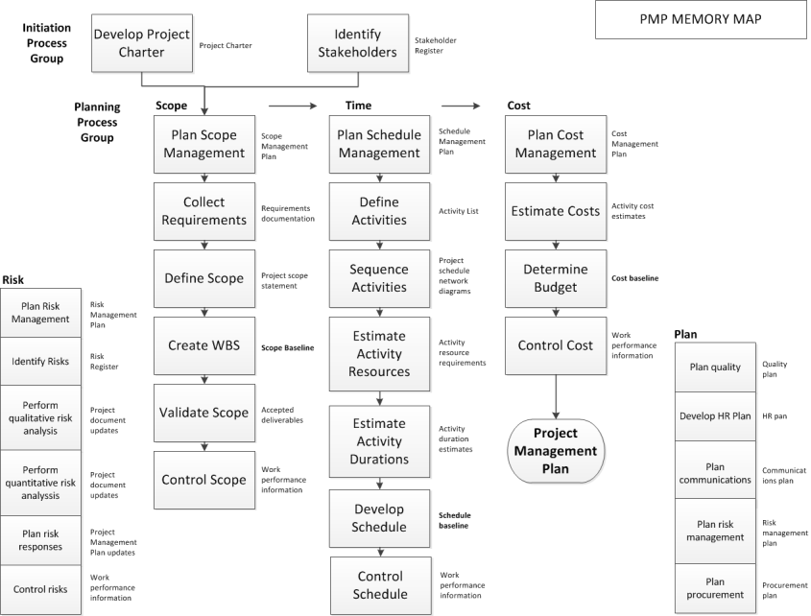
Notes:
Overview of Initiating and Planning processes.
Plan Quality output is the input to project management plan.

Slide 6
Project Quality Management
Notes:
Plan Quality- identifying quality requirements and/or standards for the project and its deliverables, and documenting how the project will demonstrate compliance with relevant quality requirements.
Should be performed in parallel with the other planning processes.
Perform Quality Assurance- Process of auditing the quality requirements and the results from quality control measurements to ensure the appropriate quality standards and operational definitions are used.
Perform Quality Control- monitoring and recording results of executing the quality activities to assess performance and recommend necessary changes.
Know the inputs, outputs and tools for the quiz.

Slide 7
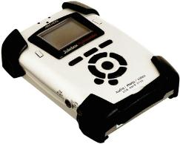

Quality vs. Grade
Quality is “the degree to which a set of inherent characteristics fulfill requirements.” (ISO 9000)
Grade is a category assigned to deliverables having the same functional use but different technical characteristics.
Notes:
Quality example – MS word or word pad have good quality
Grade example – MS word has got good grade but not word pad because word pad has basic functionality.
Both have high quality but different grades.
Grades – more features and functionality defines good grades.

Slide 8
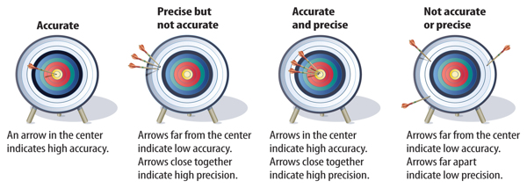
Accuracy vs. Precision
Accuracy- assessment of correctness.
Precision- measure of exactness.
Notes:
Understand difference between them.

Slide 9
Planning Quality
Cost benefit analysis
Planned vs. inspected in
Notes:
Cost benefit analysis- the benefits must outweigh the costs.
Example: Status meeting taking all day to prepare for.
Planned vs. inspected in. – for quality, we should plan well.
Example: cost of preventing mistakes is cheaper than fixing mistakes later.

Slide 10
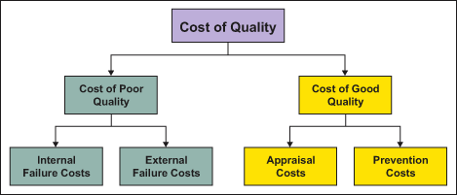
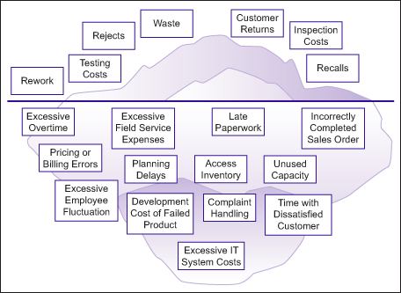
Cost of Quality
Source: www.isixsigma.com
Notes:
Cost of Poor Quality: Internal Failure Costs (before its delivered to the customers)
Caused by products or services not conforming to requirements or customer/user needs and are found before delivery of products and services to external customers. processes. Examples: Rework, delays, re-designing, shortages, failure analysis, re-testing, downgrading, downtime, lack of flexibility and adaptability.
Cost of Poor Quality: External Failure Costs (doesn’t work once it gets to the customer)
Costs that are caused by deficiencies found after delivery of products and services to external customers. Examples: Complaints, repairing goods and redoing services, warranties, customers’ bad will, losses due to sales reductions, environmental costs.
Cost of Good Quality: Prevention Costs
Prevention costs are costs of all activities that are designed to prevent poor quality from arising in products or services. Examples: Quality planning, supplier evaluation, new product review, error proofing, capability evaluations, quality improvement team meetings, quality improvement projects, quality education and training.
Cost of Good Quality: Appraisal Costs
Occur because of the need to control products and services to ensure a high quality level in all stages, conformance to quality standards and performance requirements. Examples: Checking and testing purchased goods and services, in-process and final inspection/test, field testing, product, process or service audits, calibration of measuring and test equipment.

Slide 11
Quality Reduces Cost
Notes:
Prevention activities will increase costs
With prevention comes decreased appraisal and failure costs
More prevention equals less cost at the end.

Slide 12
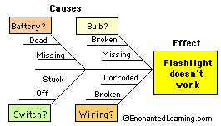
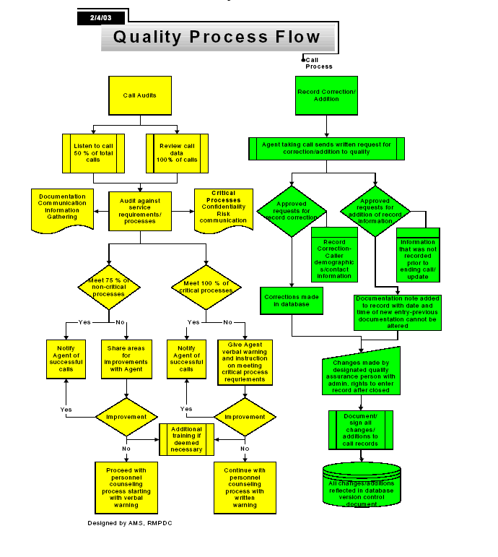
Quality Tools
Cause and effect diagrams (fishbone/Ishikawa)- identify the actionable root cause of the problem
Flowcharts (process maps)- understanding of the process and where quality can be impacted
Checksheets- gather data on the frequency of poor quality
Notes:
Fishbone – start with the pblm (bad marks in test) -> why did I do that (excuses like dint study) -> reasons for the reasons(like no time) ->why I don’t have time (wanted to sleep)
5 times why’s
It gets u closer to root cause, very helpful, used in projects
Good for collaborative studying/structured brainstorming
Checksheets – used to collect data to identify trends. Like a spreadsheet.
Just know these 7 tools for the quiz

Slide 13
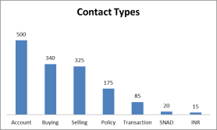
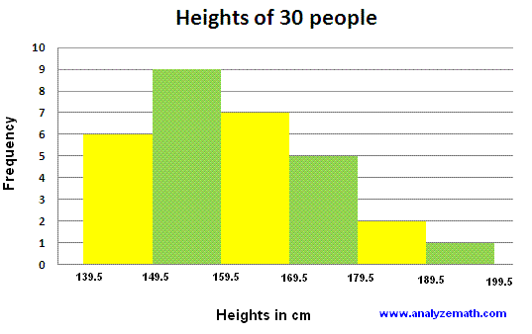
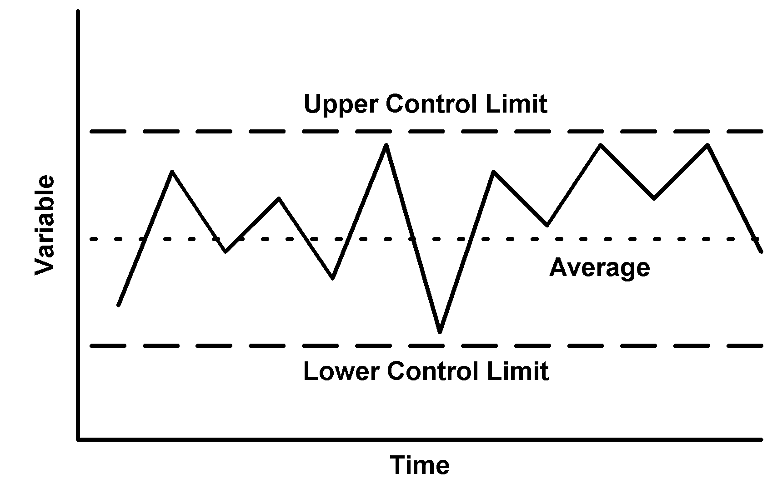
Quality Tools
Pareto diagrams- identify the largest cause of a problem, bar chart, ordered, very popular, biggest cause of the problem on the left side
Histogram- bar chart that describes central tendency of a process
Control charts- shows if a process is stable and predictable
*not actual data
Notes:
Histogram – example – quiz scores of all students, quick scan of the data to find the issue.
Control charts – used in call center.
What each chart is used for and what kind of information– for the quiz

Slide 14

Quality Tools
Scatter diagrams- seek to explain changes in variables
www.voyager.dvc.edu
Notes:
Correlation to prove your theory. To check whether the hypothesis is true.

Slide 15
Class Activity Spaghetti and Marshmallow Tower Challenge

Slide 16
Rules
Teams are assigned by project group.
You will be given a specific amount of spaghetti and marshmallows.
You will have 5 minutes to plan your approach.
You will have 20 minutes of build time.
Spaghetti and marshmallows may be broken but marshmallows may not be made wet.
You may not actively seek out other groups to poach ideas but you may spot ideas from your work station.
Once time is called a full minute will be waited before facilitator measures height. This is to ensure tower stability.
The winner is the team with the highest free standing tower.
Participation points will be given for a complete tower.
Please make sure to clean up around you.

Slide 17
Group Project
Create Quality Management Plan
Use Quality tools

Slide 18
Quality Management Plan
Create a Quality Management Plan for your project. Indicate how you will measure quality, when quality will be measured, and with what standards.
Using at least two of the ‘7 Basic Quality Tools’ provide quality data on your project.
Summarize what your results tell you and any implications or changes that need to be made.

Slide 19
PMP/CAPM Test Prep

Slide 20
Test Prep
Mnemonics for Memory Map
Practice questions

